Slide 1
MuzicApp !
Wireframe

Slide 2

Homepage

Slide 3
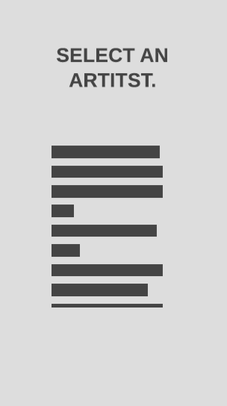
Artist selection
List of artists

Slide 4
Song Selection
Songs list

Slide 5
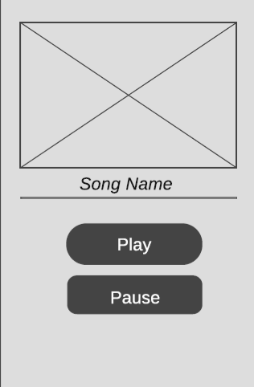
Song Page
Image of the artist

